Slide 1
A Speech Parameter Generation Algorithm Considering Global Variance for HMM-Based Speech Synthesis
Source: IEICE TRANS. INF. & SYST., VOL.E90–D, NO.5 MAY 2007
Author : Tomoki TODA and Keiichi TOKUDA
Professor : 陳嘉平
Reporter : 楊治鏞

Slide 2
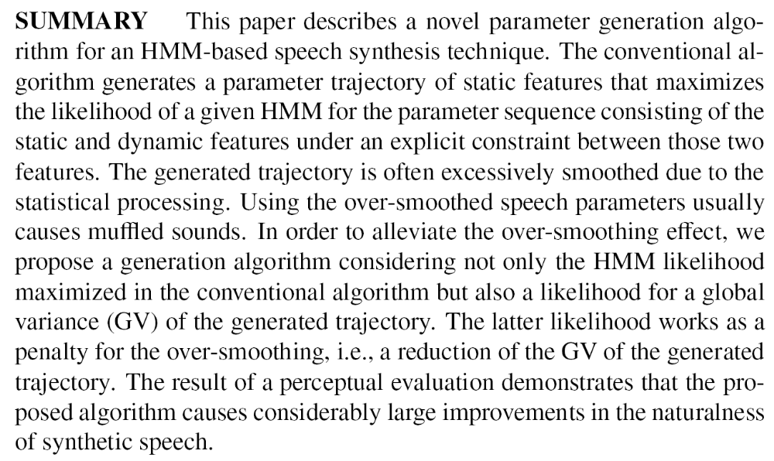

Slide 3
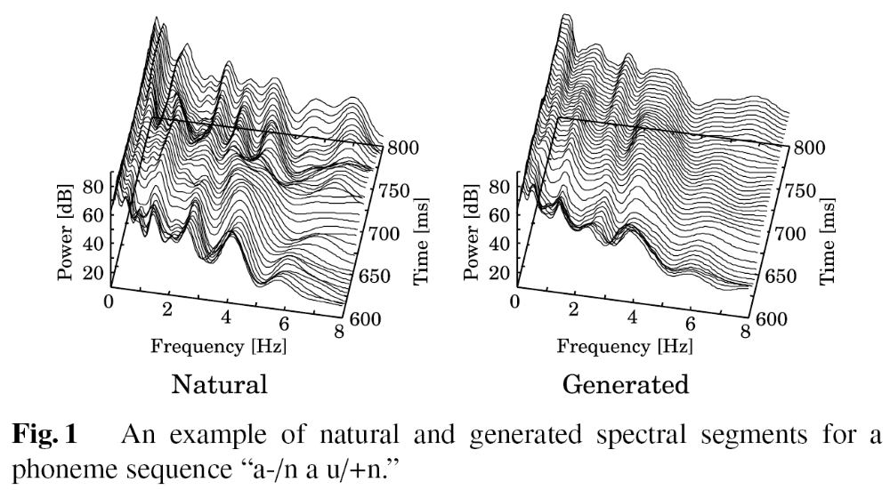
Over-Smoothing of Generated Parameters

Slide 4


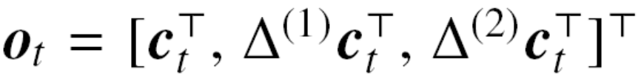


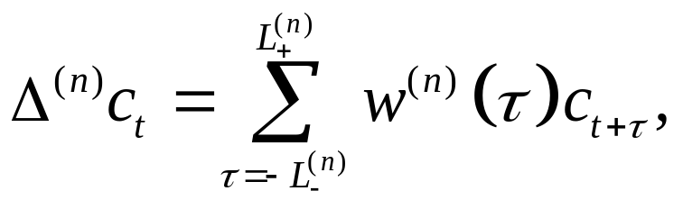
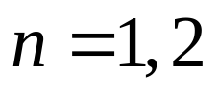
Conventional Parameter Generation Algorithm
D-dimensional static feature vector at frame .
Speech parameter vector
Dynamic feature vectors , , which are calculated by

Slide 5
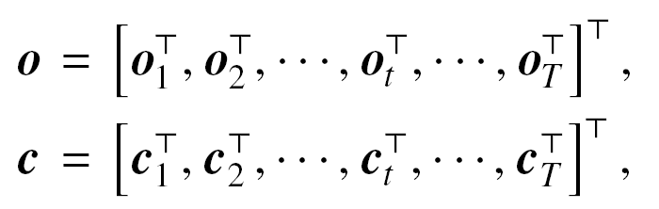
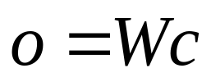

Conventional Parameter Generation Algorithm
Parameter vectors at all frames over an utterance is regarded as a time sequence vector.
The relationship between those two vectors is represented as
where is the 3DT-by-DT matrix

Slide 6
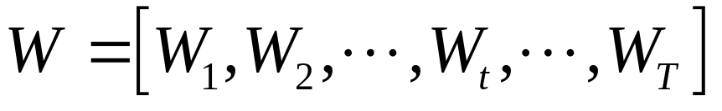
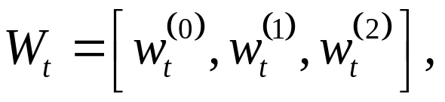
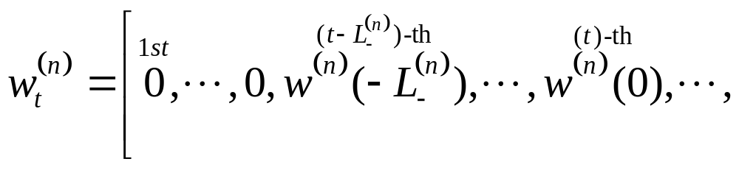
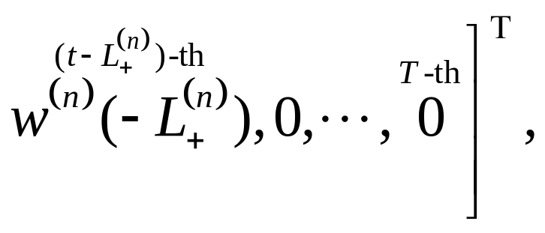

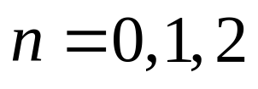
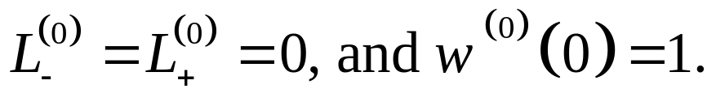

Slide 7


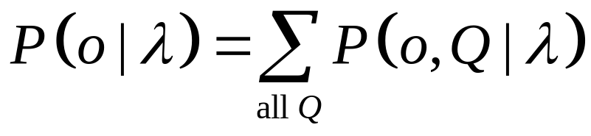
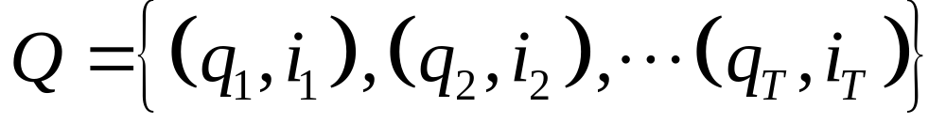
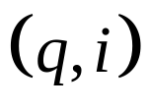
HMM Likelihood
A likelihood of a given continuous mixture HMM for the parameter sequence vector is written as
where
is the state and mixture sequence, i.e., indicates the i-th mixture of state q.

Slide 8

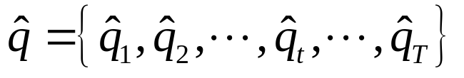
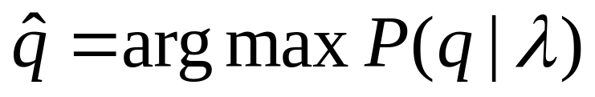

Parameter Sequence Generation Based on Maximum Likelihood Criterion
We determine the parameter sequence of static features
that maximizes the HMM likelihood.
In order to reduce computation cost, the current HMM-based speech synthesis system determines the sub-optimum state sequence independently of as follows
where is a likelihood of the state duration model.

Slide 9
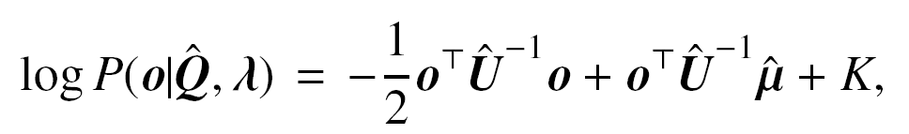
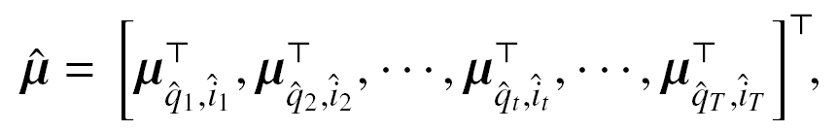
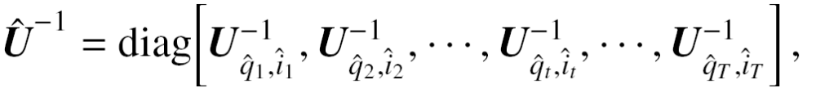
Parameter Sequence Generation Based on Maximum Likelihood Criterion
We maximize the following log-scaled likelihood with respect to ,

Slide 10
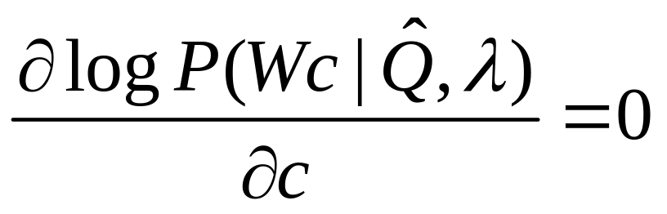
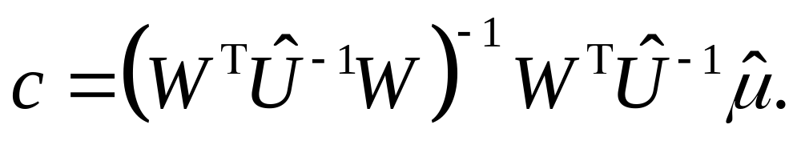

Parameter Sequence Generation Based on Maximum Likelihood Criterion
As shown in the above equation, this algorithm is not a frame-based process but a trajectory-based one, i.e., simultaneously generating static vectors at all frames.

Slide 11
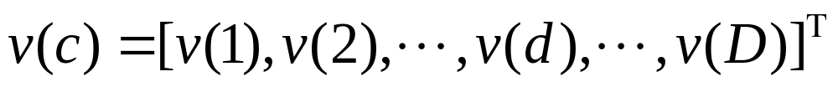

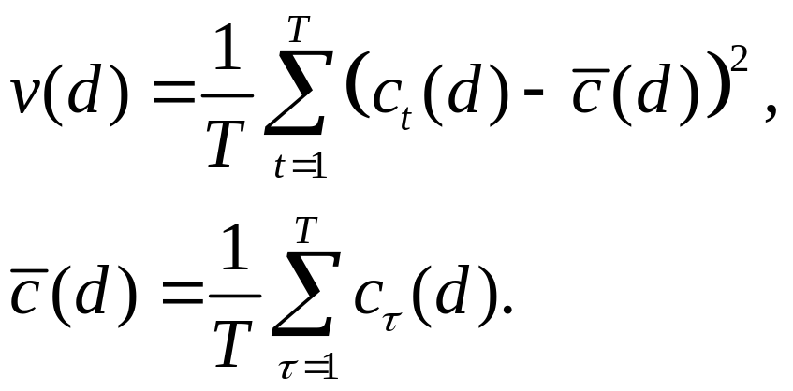
Global Variance
A GV of the static features over a time sequence is calculated by
This paper calculates the GV utterance by utterance.

Slide 12
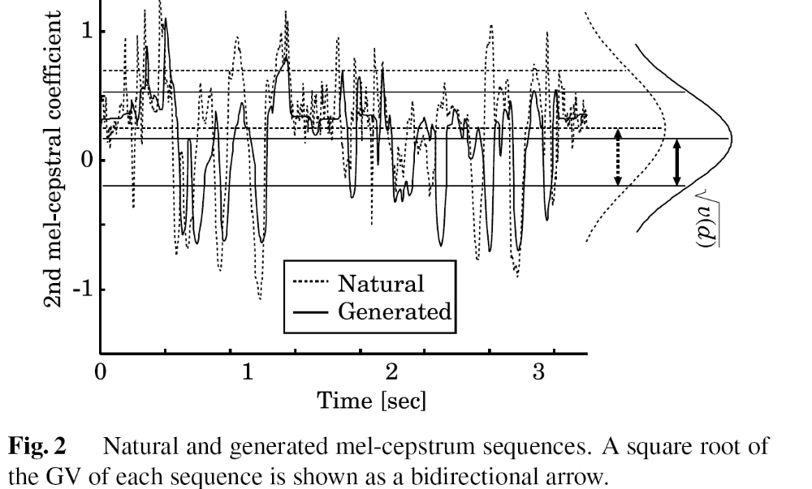

Slide 13
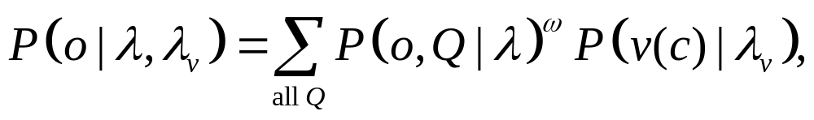
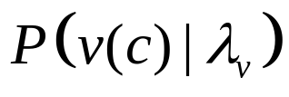

Proposed Likelihood
The proposed method considers not only the HMM likelihood for the static and dynamic feature vectors but also the likelihood on the GV.
where is modeled by a single Gaussian distribution. The constant denotes the weight for controlling a balance between the two likelihoods.

Slide 14

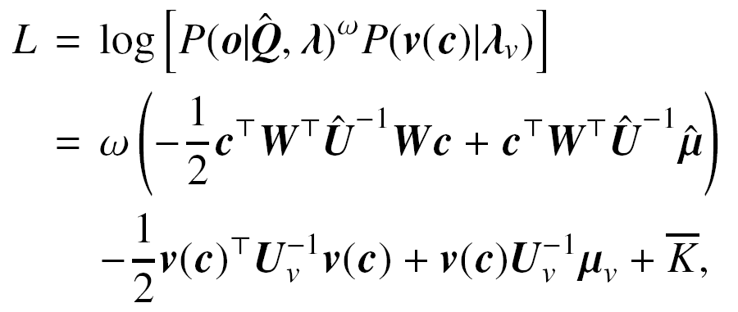
Parameter Sequence Generation Considering GV Based on Maximum Likelihood Criterion
Note that the proposed likelihood is a function of .
The following log-scaled likelihood is maximized with respect to under the condition of determined .

Slide 15
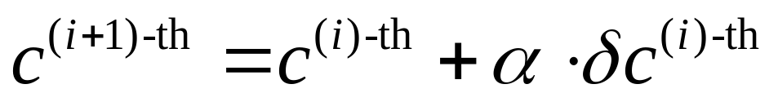
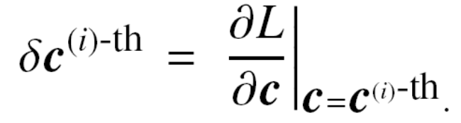
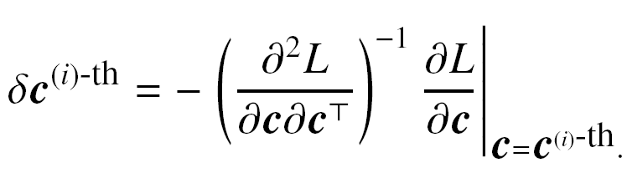
Parameter Sequence Generation Considering GV Based on Maximum Likelihood Criterion
To determine , we iteratively update with the gradient method,
Steepest decent algorithm:
Newton-Raphson method:

Slide 16
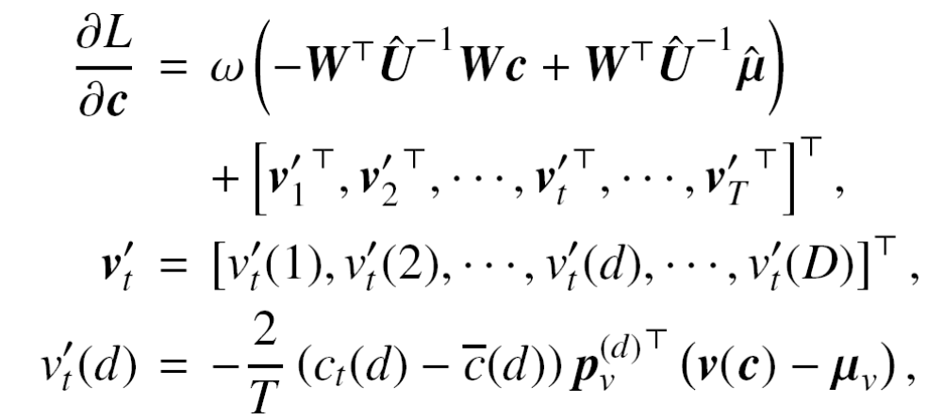


Steepest Decent Algorithm
The first derivative is calculated by
where is the d-th column vector of .

Slide 17
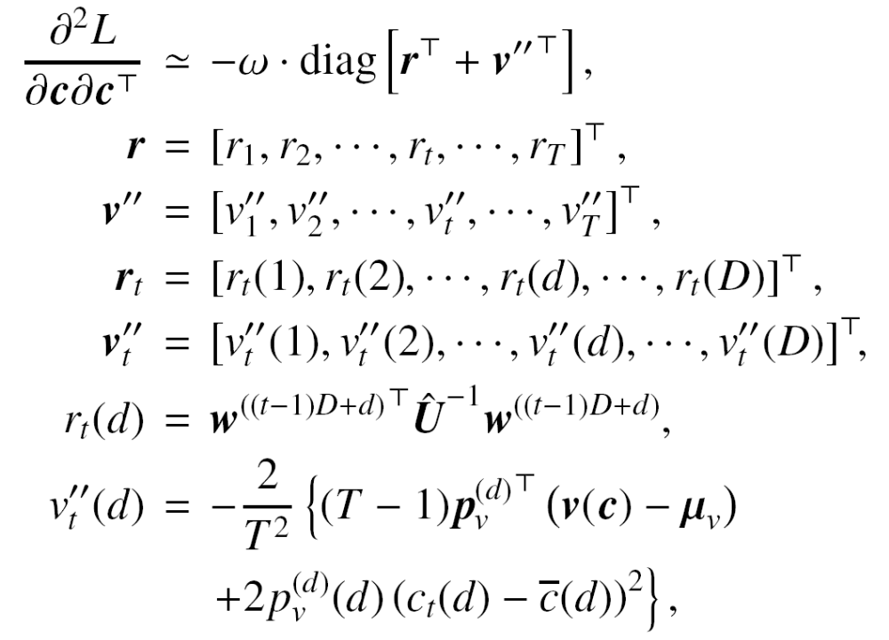
Newton-Raphson method

Slide 18
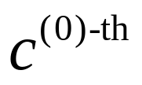

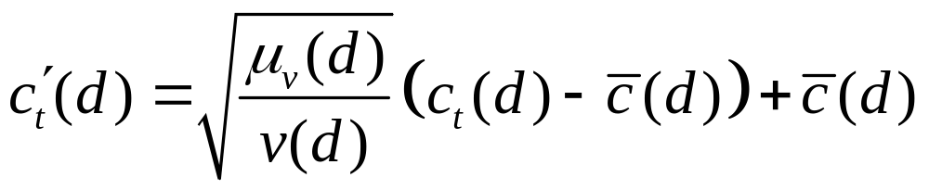
Gradient Method
There are mainly two settings of the initial trajectory .
  One is to use the conventional trajectory.
  The other is to use the trajectory linearly converted from the conventional one as follows

Slide 19
Experimental Conditions
ATR Japanese speech database
  Two males, two female
  450 sentence
As a spectral parameter, we used 0th through 24th mel-cepstral coefficients obtained from the smoothed spectrum analyzed by STRAIGHT.

Slide 20
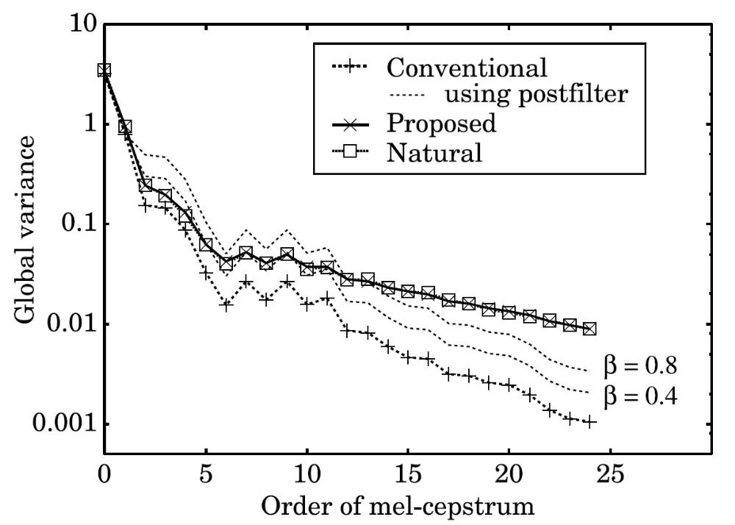
Objective Evaluations

Slide 21
Perceptual Evaluation
We conducted an opinion test on the naturalness of synthetic speech to demonstrate the effectiveness of the proposed method.
Seven Japanese listeners participated in the test.
Each listener evaluated 25 samples consisting of five sentences for each speaker.

Slide 22
